Slide 1



Transparency in Democracy
&
Political Funding
Shelly Mahajan
Senior Program Associate, Political Party Watch
Association for Democratic Reforms

Slide 2



Preview
About ADR
Part 1: Transparency in Democracy
Part 2: Transparency in Political Funding
Political Finance & Problematic Areas
Political Finance Regime in India: Issues & Challenges
Income & Sources of Funding of National Parties, FY 2019-20
Corporate Donations to National Parties, FY 2019-20: Party & Sector-wise
Corporate Donations to National Parties, FY 2019-20: Year-wise trends
Donations via Anonymous Electoral Bonds
Weak Compliance & Accountability
Legal Intervention
Need for transparency in Political Finance
The Way Forward

Slide 3

Association for Democratic Reforms (ADR), a citizen-led, non-political and non-governmental organization which has been around for more than 20 years now. Our goal is to improve governance and strengthen democracy by continuous work in the area of Electoral and Political Reforms.
  My Neta website (www.myneta.info) is an open data depository platform run by ADR which aims to empower Indian voters with the following information:
  Criminal, Financial and Educational information of candidates who have contested elections to State Assemblies, the Parliament and a few local bodies
  Details of Donations & Income-Expenditure statements of political parties

Slide 4
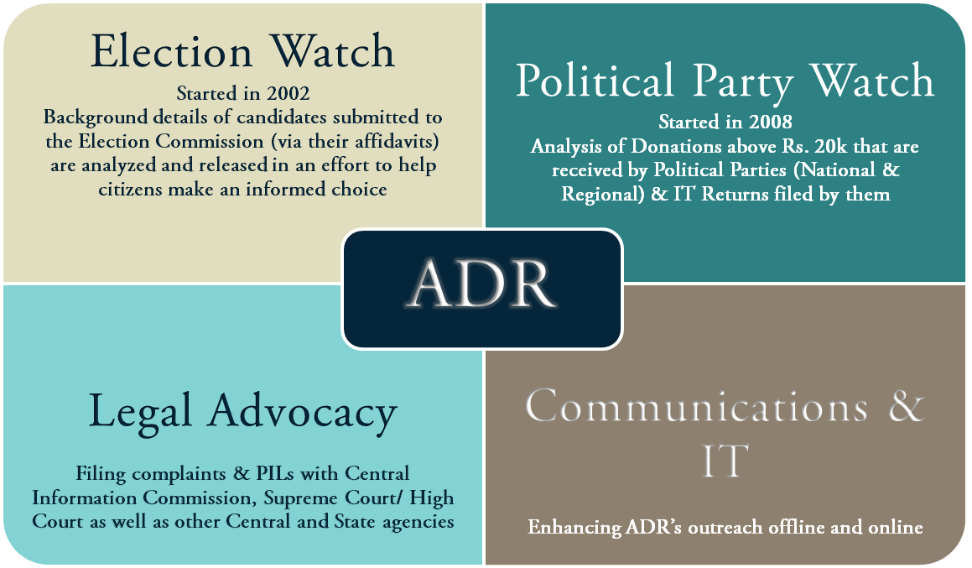

Slide 5
Part 1: Transparency in Democracy

Slide 6

Transparency in Democracy
The Democracy Index
Open Government
Some dimensions:
  Develop instruments
  E-government
  Anti-corruption matters
  Principle of accountability
People’s Right to Know
Separation of Powers
Free and fair elections
Advantages of Democracy over Dictatorship

Slide 7
Part 2: Transparency in Political Funding
Notes:
Why is it important to focus on transparency in political finance?

Slide 8

Political Finance & Problematic Areas
Parties need access to campaign finance to reach out to voters, communicate relevant information and persuade them to vote for them.
It is seen as necessary and unavoidable costs of democracy.
However, money can become a tool to unduly influence the political process.
Unequal access to funding can hurt the level-playing field.
Un-regulated political funding can result in illicit finance flows, co-optation of politics by business interests and wide-spread vote buying.
This distorting effect of money on the democratic process demands effective regulation and implementation.

Slide 9


Political Finance regime in India – Issues and Challenges
ECI’s transparency guidelines lack statutory authority and legal consequence for non-compliance.
Absence of frequent and complete scrutiny of financial disclosures of parties by tax authorities.
Section 77 of RPA, 1951 only regulates “individual” candidates’ and not parties’ expenditures.
No restriction on the amount that corporate entities may contribute to political parties.
No requirement for corporates to report political contributions in profit and loss accounts.
Parties need not reveal names of individuals/organizations who donated via anonymous Electoral Bonds.
Non-disclosure provisions have legalized anonymous donations.
70 per cent of the funds of National Parties cannot be traced and are from ‘unknown sources’ (ADR Report).
Rs 20,000 limit easily evaded as disclosure of donor is not required.
Notes:
Recent developments are opposite of the spirit of transparency

Slide 10
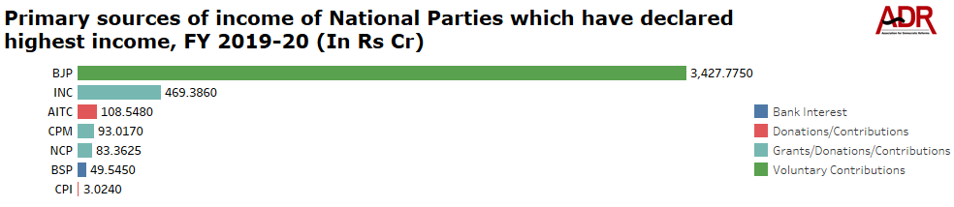
Income of National Parties, FY 2019-20
National Parties that received highest income from donations/contributions include BJP – Rs 3427.775 cr, INC – Rs 469.386 cr, AITC – Rs 108.548 cr, CPM – Rs 93.017 cr and CPI – Rs 3.024 cr.
Voluntary Contributions of Rs 3427.775 cr declared by BJP forms 94.60% of its total income during FY 2019-20.
Declaration of Rs 469.386 cr under Grants/ donations/ contributions by INC forms the top most income of the party, contributing 68.80% of its total income during FY 2019-20.
AITC, CPM, NCP and CPI declared the highest income from grants/donations/voluntary contributions worth Rs 108.548 cr, Rs 93.017 cr, Rs 83.3625 cr and
Notes:
Before we proceed with any further discussion on the need for transparency – lets look at some vital data

Slide 11
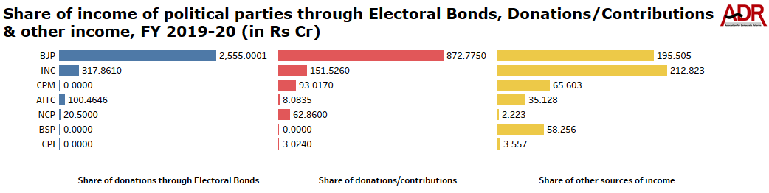
Income of National Parties, FY 2019-20
BJP, INC, AITC and NCP collected 62.92% (Rs 2993.826 cr) of their total income from donations through Electoral Bonds. BJP received Electoral Bonds worth Rs 2555.0001 cr, INC received Rs 317.861 cr, AITC received Rs 100.4646 cr and NCP received Rs 20.50 cr.
6 National Parties, declared receiving an income from Donations/Contributions, a total of Rs 1191.285 cr.
Rs 573.095 cr was income generated through other sources of income by National parties during FY 2019-20.
Notes:
See the gaps in the income and different sources

Slide 12
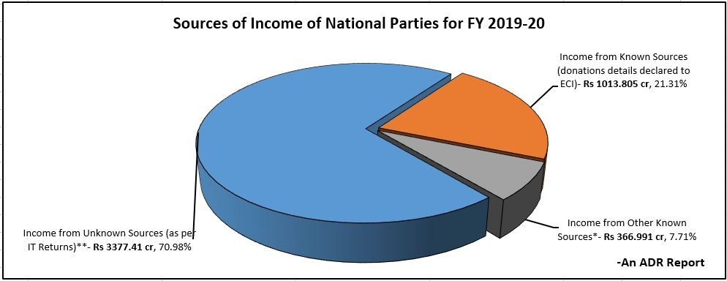
Sources of Funding of National Parties, FY 2019-20
Unknown sources are income declared in the IT returns but without giving source of income for donations below Rs 20,000. Such unknown sources include ‘donations via Electoral Bonds’, ‘sale of coupons’, ‘miscellaneous income’, ‘voluntary contributions’, ‘contribution from meetings/morchas etc.
During FY 2019-20, National parties received Rs 3377.41 cr from unknown sources; 70.98% of their total income of Rs 4758.206 cr.
National parties collected Rs 14,651.53 cr from ‘Unknown Sources*’ between FY 2004-05 to 2019-20.
* include voluntary contributions (< Rs 20,000), donations via Electoral Bonds, collection from Sale of Coupons etc.
Notes:
Unknown sources of income and the huge proportion it makes

Slide 13
Sources of Funding of National Parties, FY 2019-20
BJP and INC received Rs 2642.63 cr or 78.24% and Rs 526 cr or 15.57% respectively, of total income of National parties from unknown sources.
In FY 2019-20, 70.98 per cent of the total income of National parties cannot be traced and are from ‘unknown sources’.
Between FY 2004-05 and 2018-19, National parties collected Rs 11,234.12 cr from ‘unknown sources’.
Non-disclosure provisions have legalized anonymous donations to the tune of Rs 6534.78 cr via Electoral Bonds since March 2018.
Notes:
This hurts the level-playing field. Can we talk about free and fair elections in this context?

Slide 14
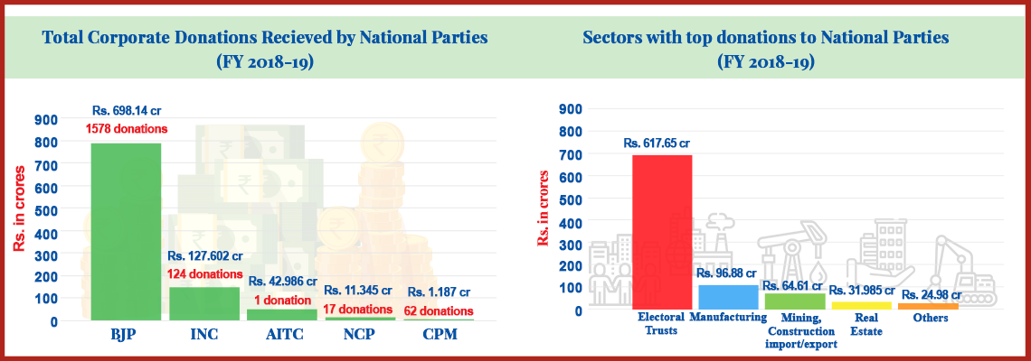
Political Finance regime in India – Issues and Challenges
Unlimited Corporate Donations
No limit on corporate donations to political parties (earlier limit of 7.5% removed after amendment to Section 182 of Companies Act 2013 in 2017).
No requirement for corporates to report political contributions in profit and loss accounts.
National parties received Rs 881.26 cr from corporates/business houses in FY 2018-19. Donations from corporates to National Parties increased by 133% between 2004-12 and 2018-19.

Slide 15
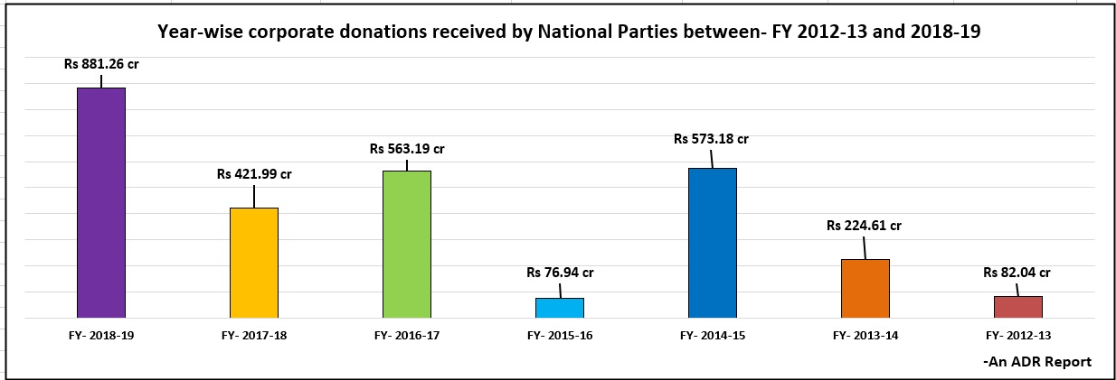
Notes:
Increase between FY 2017-18 (amendment) to FY 2018-19

Slide 16
Electoral Bonds Scheme, 2018

Slide 17
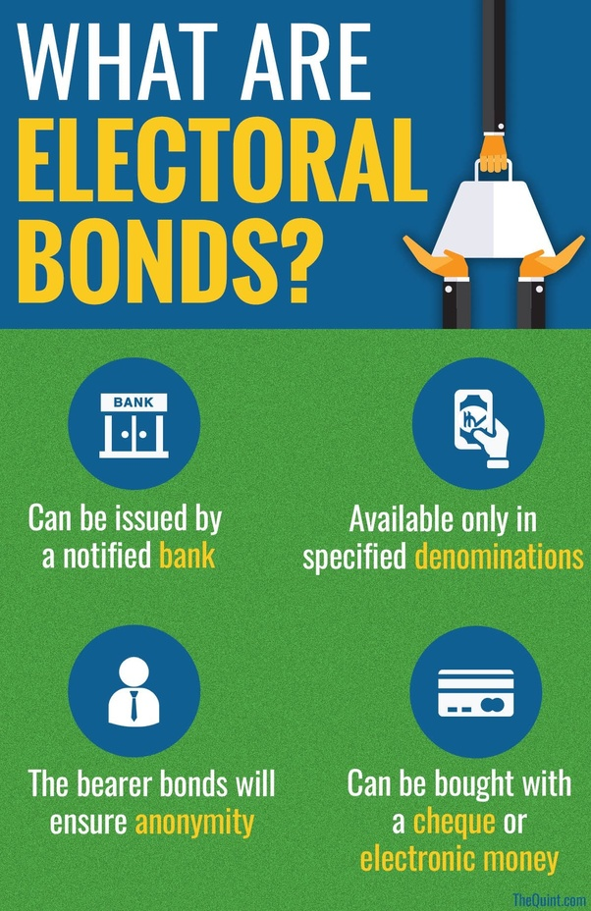

KEY FACTS ABOUT ELECTORAL BONDS
GoI had notified the Electoral Bond Scheme, 2018 vide Gazette Notification No. 20 dated 02nd January, 2018
Only registered political parties that have secured not less than one per cent of the votes polled in the last general election to the House of the People or the Legislative Assembly, as the case may be are eligible to receive electoral bonds
Does not carry the name of the buyer or payee (anonymous), no ownership information is recorded and the holder of the instrument (i.e. political party) is presumed to be its owner.
Bonds not encashed within the validity period of fifteen days shall be deposited by the authorised bank to the Prime Minister Relief Fund
Every political party in its income tax return (ITR) will have to disclose the amount of donations it has received through electoral bonds to the Election Commission
Notes:
This was introduced as a reform for transparency but it is important that we understand how contrary it is

Slide 18
Total Amount of Electoral Bonds Sold
99.69% of the bonds purchased during the fifteen phases encashed by the political parties within the validity period
12,924 bonds
worth Rs 6534.78 cr
Electoral Bonds Sold and Redeemed during the fifteen phases
(March 2018 – January 2021)
Total Amount of Electoral Bonds Redeemed
144 bonds worth Rs 20.2833 cr (0.31%) deposited in the PMRF
12,780 bonds
worth Rs 6514.50 cr

Slide 19
Details of Electoral Bonds sold & Redeemed
Phases I-XV
55.43%
of the total value of electoral bonds purchased in two months alone – March 2019 (phase VIII) and April 2019 (phase IX) – period of general elections
BONDS SOLD
BONDS REDEEMED
Denomination: Rs 1 crore
Number: 6015 bonds (46.54%)
Value in Rs Cr: Rs 6015 cr (92.046%)
Denomination: Rs 1 crore
Number: 6003 bonds (46.97%)
Value in Rs Cr: Rs 6003 cr
(92.15%)
55.51%
of the total value of electoral bonds redeemed in March 2019 (phase VIII) and April 2019 (phase IX) – period of general elections
Denomination: Rs 10 lakhs
Number: 5021 bonds (38.85%)
Value in Rs Cr:
Rs 502.10 cr (7.68%)
Denomination: Rs 10 lakhs
Number: 4941 bonds (38.66%)
Value in Rs Cr:
Rs 494.10 cr (7.58%)
Notes:
Cycles opened prior to Delhi and Bihar elections; so we know where all the anonymous money is going and from given the nature of denominations

Slide 20
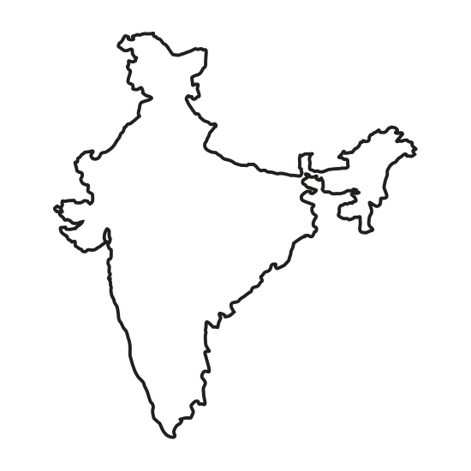

Top five cities with highest (by amount) sale and encashment of Electoral Bonds – Phases I-XV
City-wise Electoral Bonds Sold
City-wise Electoral Bonds Redeemed
1. Mumbai
3042 bonds
Rs 2022.964 cr
9108 bonds
Rs 5013.52 cr
1. New Delhi
2. Kolkata
3676 bonds
Rs 1527.458 cr
1394 bonds
Rs 608.552 cr
2. Hyderabad
3. New Delhi
1704 bonds
Rs 953.87 cr
561 bonds
Rs 313.50 cr
3. Bhubaneswar
1623 bonds
Rs 866.37 cr
813 bonds
Rs 257.244 cr
4. Hyderabad
4. Kolkata
772 bonds
Rs 353.76 cr
553 bonds
Rs 151.132 cr
5. Mumbai
5. Bhubaneshwar

Slide 21
Total donations via Electoral Bonds declared by Political Parties, FY 2019-20
Rs 3441.324 cr
(total donations via electoral bonds declared by parties for FY 2019-20)
4 National Parties – BJP, INC, NCP & AITC – declared donations worth Rs 2993.826 cr via electoral bonds
14 Regional Parties – TRS, YSR-C, BJD, DMK, SHS, AAP, JDU, SP, TDP, JDS, SAD, AIADMK, RJD& JMM – declared Rs 447.498 cr via electoral bonds
Period Covered: April 2019 to March 2020 (Phases IX – XIII)
Rs 3429.5586 cr
(total electoral bonds redeemed by political parties during FY 2019-20, as per SBI)
Notes:
The earlier slides are based on data from SBI – trend analysis over the 18 phases and we see spike in the amount of electoral bonds purchased during election period; level playing field. FY 2019 separate figures of bonds for BJP and INC; 87.29% of EBs are received by 4 National Parties. Difference among NP as well as among NP and RP

Slide 22
ADR's petition challenging Finance Act, 2017;
Electoral Bonds & Removal of company's limit to donate
This petition, filed on 4th Sept’17, challenges the Finance Act, 2017 which was enacted as a money bill which introduced the Electoral Bonds Scheme, 2018.
On 5th March, 2019 ADR filed an application for stay against the sale/purchase of electoral bonds for Lok Sabha 2019 elections. ADR had contended that enormous amount of corporate funding would be received by political parties during the general elections and this would play a critical role in the elections.
In response to ADR’s application, the SC in its interim order dated 12th April, 2019 directed all political parties to submit details of donations received via Electoral Bonds to the ECI in a sealed cover on or before 30th May 2019.
The aforesaid information was analysed by ADR, which raised several questions on the execution of the Scheme.
ADR filed another application in the SC on 29th November 2019 to bring on record certain vital documents which have surfaced recently and have a strong bearing on the instant case.
On 26th October, 2020 ADR and Common Cause filed a third application for an urgent listing of the petition before the Supreme Court of India before the Bihar Legislative Assembly Elections, 2020.
On 9th March, 2021, ADR and Common Cause filed a fourth application for stay on any further purchase of Electoral Bonds before the upcoming state elections in West Bengal, Tamil Nadu, Kerala, Puducherry and Assam as it would further increase the illegal, illicit and anonymous political funding.
On 23rd August, 2021, ADR and Common Cause filed fifth application for an urgent listing of the petition before the Supreme Court of India seeking a direction to the Centre not to open any further window for sale of electoral bonds
Final Status: SC declined to stay the operation of the Electoral Bonds Scheme.
Next hearing date: To be decided

Slide 23
Problematic Areas
The vote share of the remaining 42 parties range between 0.86% and 0.0003%.
Only 1 registered unrecognised party of the 43 parties analysed found eligible to receive electoral bonds, as per the Electoral Bond Scheme, 2018.
69*
registered unrecognised parties that submitted details to ECI in sealed cover complying with SC’s interim order, the reqd. vote share details of only 43 parties were available to assess their eligibility.
No scrutiny by any authority at any stage prior to redemption of Electoral Bonds by political parties not eligible to encash bonds under the Electoral Bond Scheme, 2018.
10
Reg. Unrecognised parties that submitted their details in sealed cover to the ECI were registered in March and April 2019. None of these had contested any elections before the 2019 General Elections.
There was little or no demand for bonds of lower denominations, like Rs 10,000 or Rs 1 lakh, suggesting that max donations are made by corporates and not by salaried individuals/small businessmen.
As per ADR analysis, majority of the Electoral Bonds were received by the governing party – 67.98% - In the last three FYs.
*After counting the repeated party names (Bharatiya Rashtriya Morcha & Rashtriya Republican Party) once.
Notes:
ADR petition – sealed cover; how does SBI even ensure the evaluation of eligibility criteria?; PP not required to keep a record of the EBs donor identity or report the same to ECI. Has EBs managed to be an electoral reform which Jaitley claimed?

Slide 24
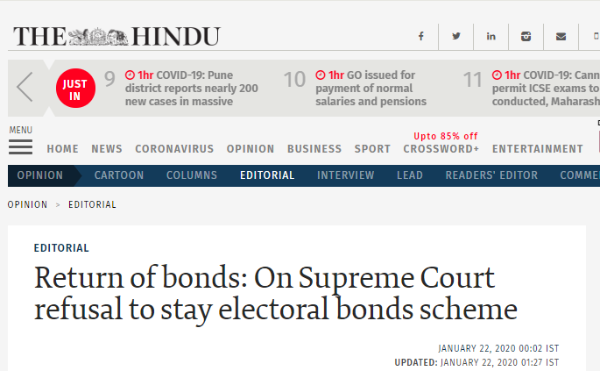
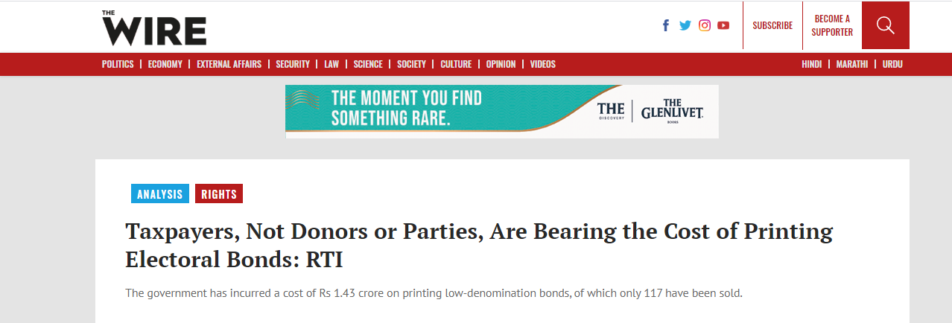
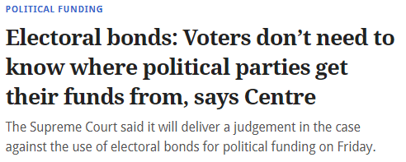
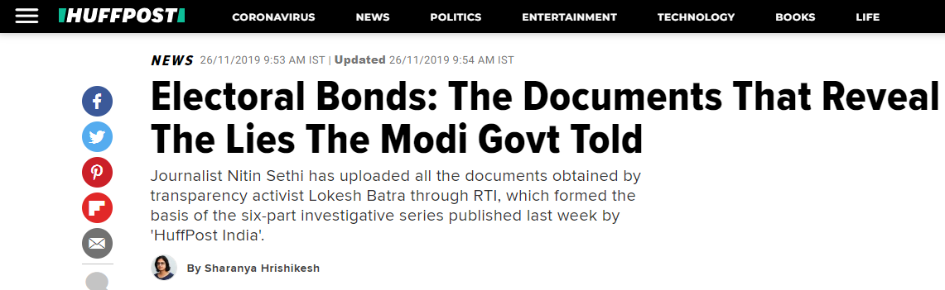
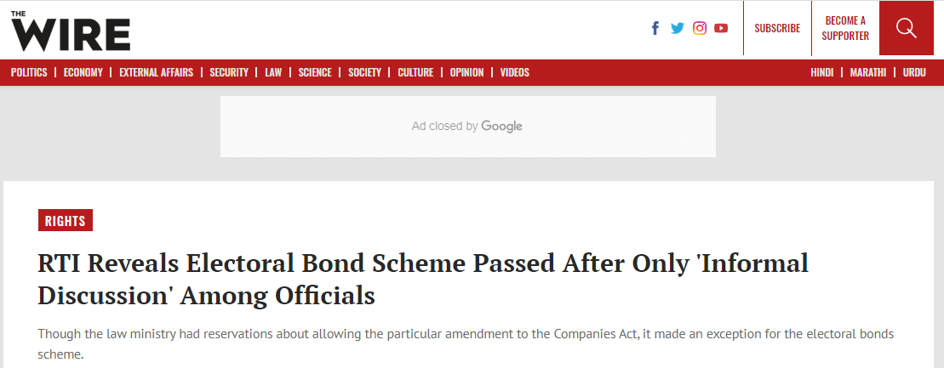
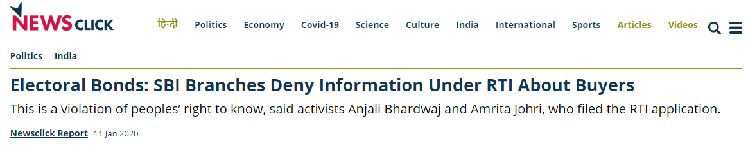
Controversies

Slide 25
Weak Compliance & Accountability
Nearly all forms of organized activity are regulated by proper laws. However, the word “political party” is rarely used in the Constitution, and there is no comprehensive law for political parties.
None of the six political parties have complied with the CIC’s 2013 order. The commission issued show-cause notices to the political parties for non-compliance, hearings on November 21, 2014 and consequently on the 7th of January, 2015, but all the parties were conspicuously absent from both the hearings.
Political parties regularly delay/default on the submission of their annual audit accounts/contributions reports. While law recommends suspension of tax relief of parties in such cases, however, not a single case can be cited where a parties’ tax relief was withdrawn.
For FY 2019-20, 17 and 26 of the 54 Regional Parties have not declared their Annual Audit reports and Contributions reports respectively, with the ECI.
For FY 2012-13 to 2017-18, contributions declared by National parties of Rs 15 cr have incomplete/erroneous PAN details.
Despite EC having overarching powers, there are almost no provisions with respect to penalties on defaulters. Once a political party is registered, EC has no powers to review the registrations for having violated the undertaking given at the time of registration.
S. No. | Party Name | No. of times submission delayed to ECI (FY 2013-14 to 2019-20)
 |  | Annual Audit Report
1 | BJP | 7
2 | INC | 6
3 | NCP | 6
4 | CPI | 5
5 | CPM | 0
6 | AITC | 0
7 | BSP | 0

Slide 26
Petition of Lok Prahari – disproportionate asset increase of the MPs & MLAs. Supreme Court made it mandatory for candidates to declare sources of income of spouse and dependents in Form 26 of affidavits.
Petition against non-compliance by National Political Parties, of CIC’s 2013 judgment that brought National Parties under the ambit of the RTI Act and declared them as ‘public authorities’.
Legal Interventions
PIL on the regulation and monitoring of Election Expenditure of the Political parties.
PIL in the SC against Electoral Bonds and removal of the 7.5% of the company's aggregate limit to donate
PIL in SC against amendments in the FCRA, 1976 and 2010

Slide 27
Need for transparency in political finance
To guarantee independence of parties from undue influence of big donors, ensure that they compete on equal footing, and that they practice transparency in political financing.
UN Human Rights Committee in General Comment No. 25 (The right to participate in public affairs, voting rights, and the right to equal access to public service) adopted in 1996. Transparency and accountability in political financing is integral to such a framework.
255th Law Commission of India Report: Openness in political finance reporting reduces the prevalence of black money, bribery and crony capitalism in electoral politics.
Huge contributions though legal, can result in “institutional corruption” which may compromise the political morality norms of a republican democracy.
Transparency and accountability in political funding promote electoral participation of women and other marginalised groups given their unequal access to funds.

Slide 28
The Way Forward
Transparency & Disclosure
Bring political parties under RTI, 2005 in compliance with CIC’s 2013 order.
Abolish cash donations altogether.
Disclose names, addresses and PAN details of donors and donation amount even for contributions less than Rs 20,000.
‘Electoral Trusts Companies’ scheme 2013 should be amended to have a retrospective effect.
Sources of funds (above Rs 20,000) received by parties during the election period to be reported as part of their election expenditure statement.
If state funding is adopted, its should be preceded by reforms such as decriminalisation of politics, inner-party democracy, electoral finance reform, transparency and accountability in political funding etc.
Status of submission of reports by political parties should be made available on ECI website.

Slide 29
The Way Forward
Ensuring Compliance & Accountability
Requirement of a law regulating political parties, party constitution, organization, internal elections, candidate selection etc.
Penalty (fine) for non-compliance, de-recognition in extreme cases while penalty for filing false information should be up to a maximum of fifty-lakh rupees.
Electoral Trust(s) that fail to submit annual report of contributions in the prescribed format should not be entitled to tax relief for such financial year and should be fined.
Continuation of non-compliance beyond 90 days should result in banning the trust from receiving donations in future.
Empowering the ECI
Power to ECI to de-recognize political parties and/or impose strict penalties in case of non-compliance.
ECI transparency guidelines need to be given statutory backing.
Scrutiny of financial documents submitted by parties to be conducted annually by a body approved by CAG and ECI.
Political parties inactive over a prolonged period, do not take part in any election and continue to receive donations through Electoral Bonds should be de-listed by the ECI from time to time.

Slide 30
Thank You !

